Slide 1


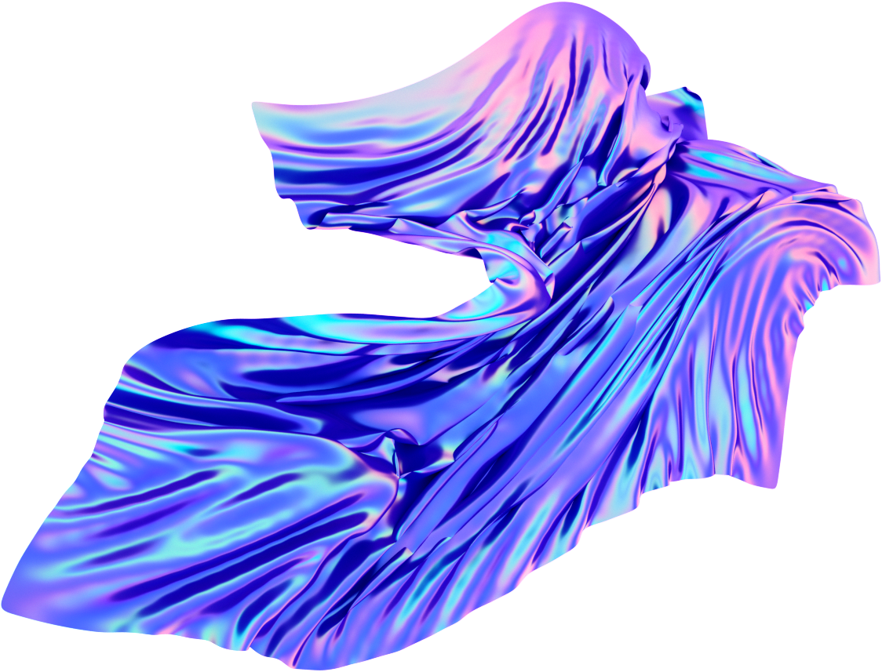



DRDO Assignment
Name - Sneha Dadhich
College - Jodhpur Institute of Engineering and Technology
Year - 4th year ( 7th Semester )
Topic - Basics of Image Processing

Slide 2

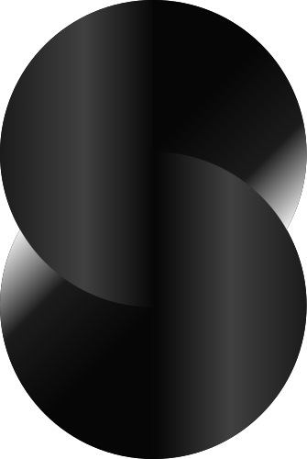
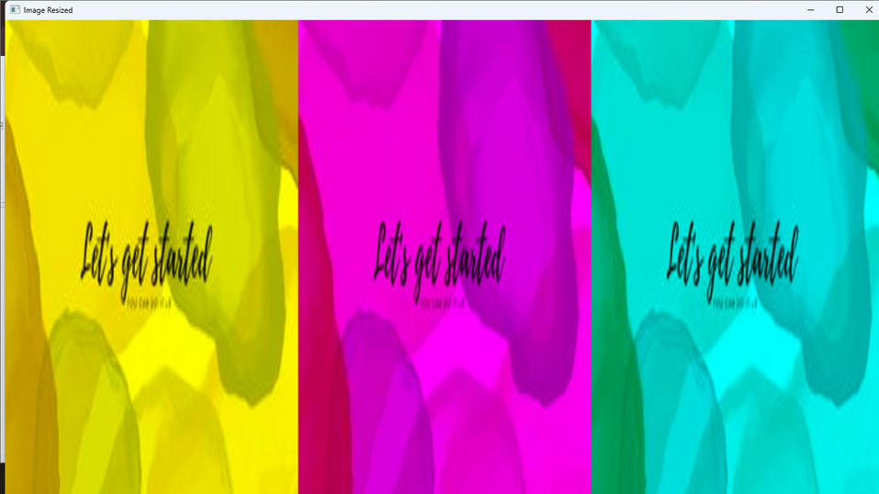
Topics Learnt
Introduction to Image Processing
Applications of Image Processing

Slide 3

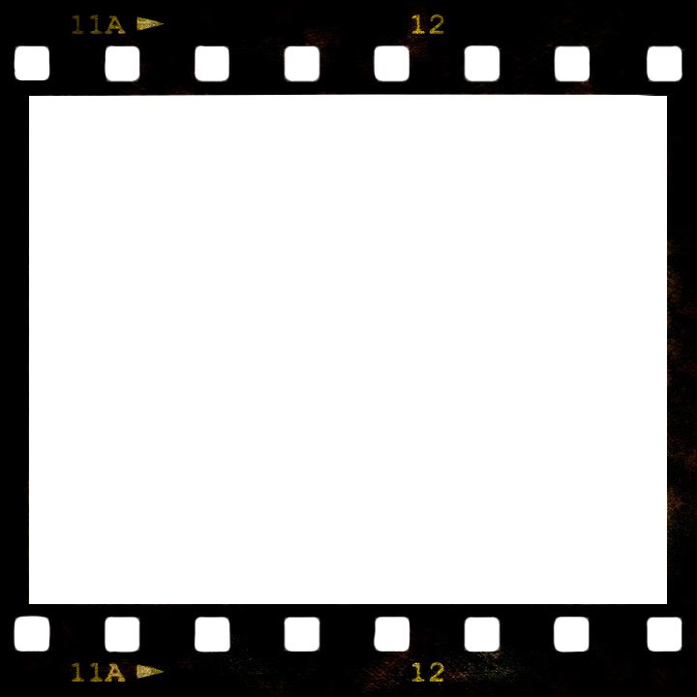
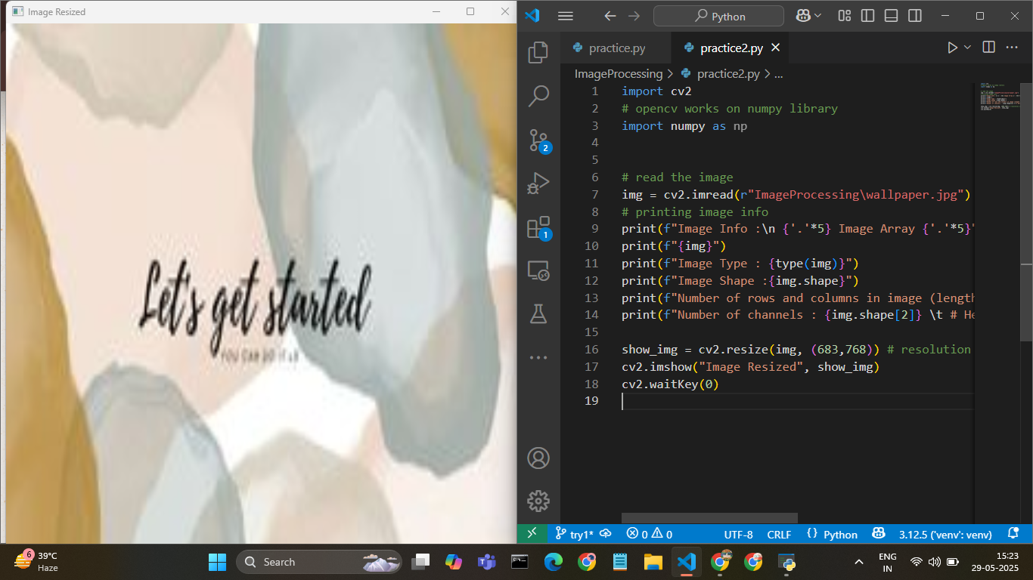
Image Processing
Image processing is a method to perform operations on an image to enhance it or extract useful information. It involves manipulating pixel values of images using mathematical and logical operations.

Slide 4


Applications of Image Processing
Medical Imaging: CT scans, MRI enhancements
Object Detection: Surveillance, autonomous vehicles
Face Recognition: Authentication systems
Optical Character Recognition (OCR): Digitizing text from images
Industrial Automation: Detecting defects, sorting objects
Augmented Reality & Gaming: Real-time background replacement, motion capture

Slide 5
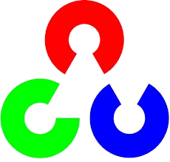
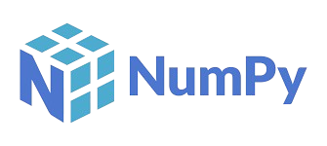
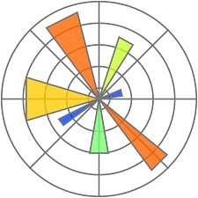
Libraries Used
Opencv
OpenCV is an open-source computer vision library that enables real-time image and video processing, widely used in machine learning, robotics, and object detection applications.
Numpy
NumPy is a powerful Python library for numerical computing, providing support for large multi-dimensional arrays, mathematical functions, linear algebra, and random number capabilities.
Matplotlib.pyplot
Matplotlib.pyplot is a Python plotting library used for creating static, interactive, and animated visualizations, offering MATLAB-like functions for charting data easily and flexibly.
Opencv
Numpy
Matplotlib

Slide 6
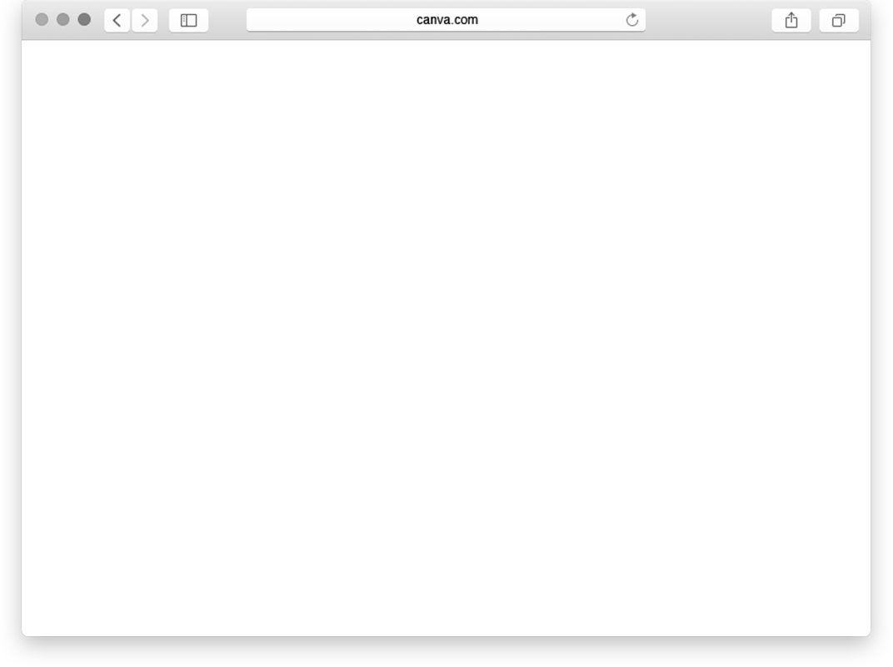
Basic Image Operations
Reading and Displaying Images:
import cv2
img = cv2.imread("image.jpg")
cv2.imshow("Window", img)cv2.waitKey(0)
cv2.destroyAllWindows()

Slide 7
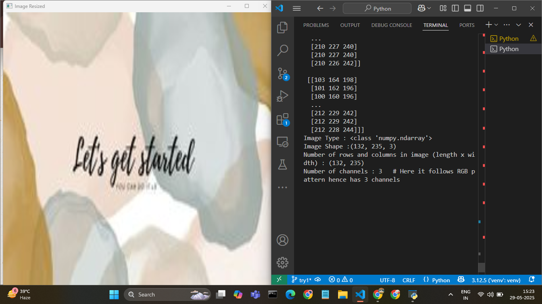
Basic Image Operations
Displaying Images Properties :
print(f"Image Info :\n {"."*5} Image Array {"."*5}")
print(f"{img}")
print(f"Image Type : {type(img)}")
print(f"Image Shape :{img.shape}")
print(f"Number of rows and columns in image (length x width) : {img.shape[:2]}")
print(f"Number of channels : {img.shape[2]} \t # Here it follows RGB pattern hence has 3 channels")

Slide 8
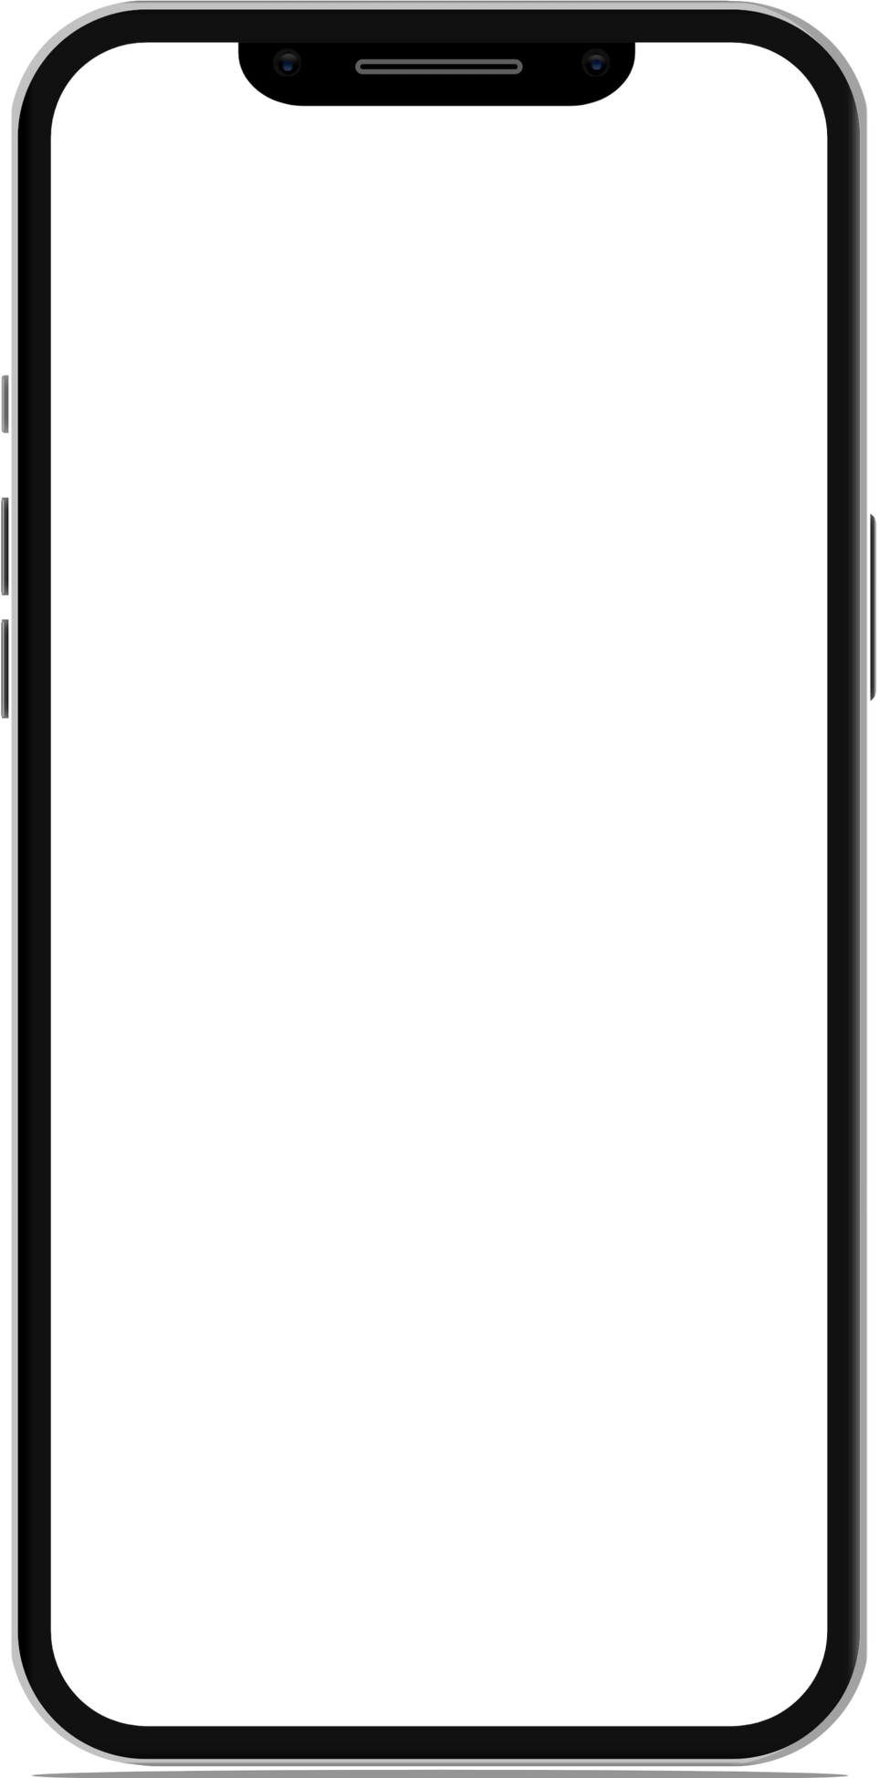
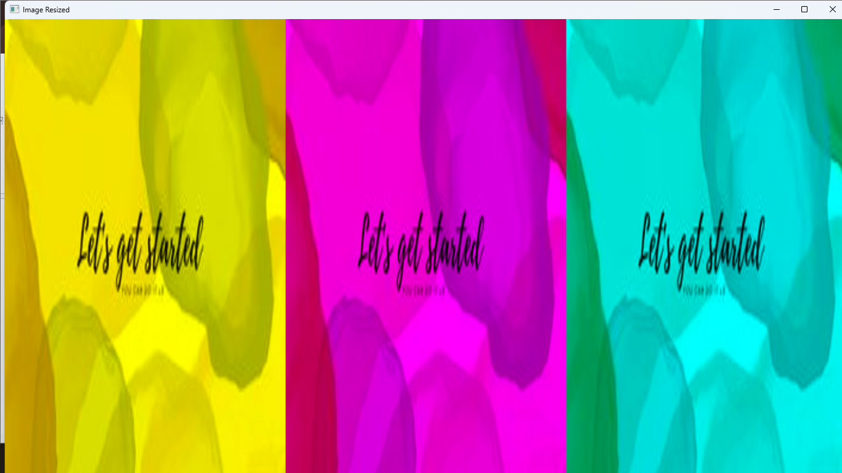
Image Manipulation
Color Channels (BGR):
# CONVERTING THE IMAGE TO ONLY BLUE, GREEN, RED
IMG_SAVED1, IMG_SAVED2, IMG_SAVED3 = IMG.COPY(), IMG.COPY(), IMG.COPY()
IMG_SAVED1[:,:, 0] = 0
IMG_SAVED2[:,:, 1] = 0
IMG_SAVED3[:,:, 2] = 0
IMG_SAVED4 = NP.HSTACK( (IMG_SAVED1, IMG_SAVED2, IMG_SAVED3) )
SHOW_IMG = CV2.RESIZE(IMG_SAVED4, (683,768)) # RESOLUTION OF LAPTOP - 1366X768
CV2.IMSHOW("IMAGE RESIZED", SHOW_IMG)
CV2.WAITKEY(0)

Slide 9
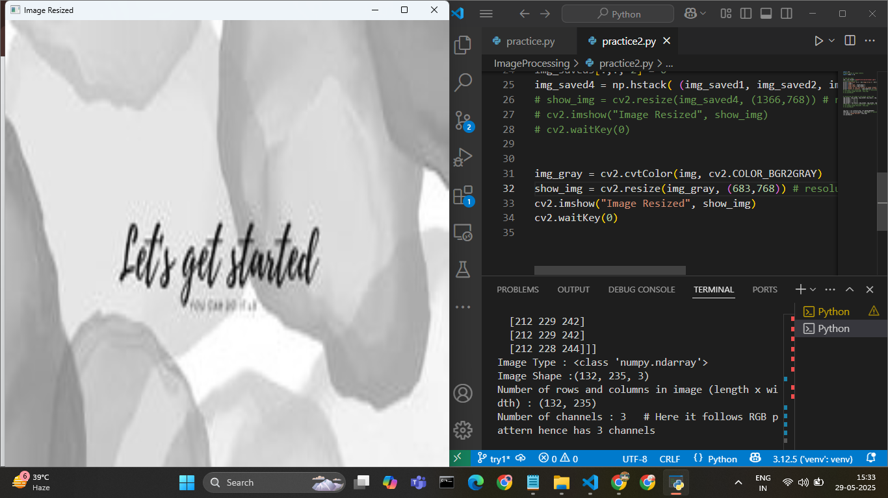
Image Manipulation
Grayscale Conversion:
IMG_GRAY = CV2.CVTCOLOR(IMG, CV2.COLOR_BGR2GRAY)
SHOW_IMG = CV2.RESIZE(IMG_GRAY, (683,768)) # RESOLUTION OF LAPTOP - 1366X768
CV2.IMSHOW("IMAGE RESIZED", SHOW_IMG)
CV2.WAITKEY(0)

Slide 10
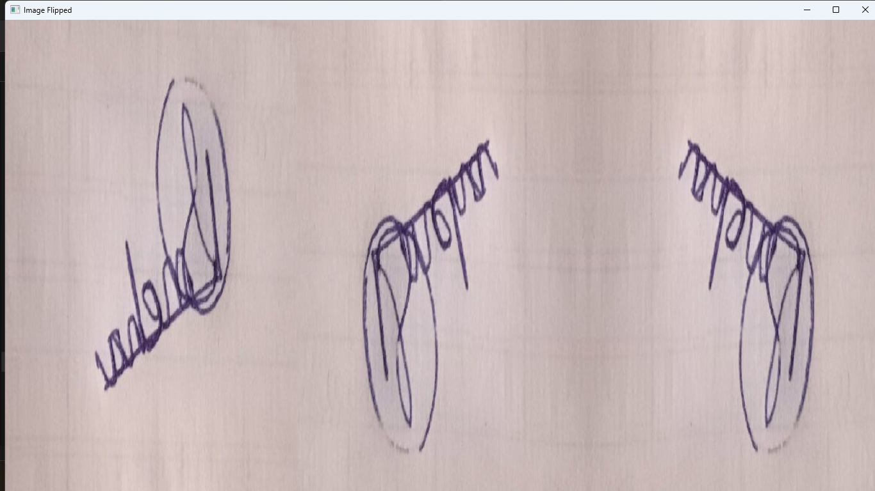
Image Manipulation
Flipping the Image
# FLIPPING THE IMAGE
# 0 means 180 degree, 1 means 360 degree
# 0 means flip by Vertical Axis and 1 means flip by Horizontal Axis
# -1 means flip by both vertical and horizontal axis
img_flip1 = cv2.flip(img, 1)
img_flip2 = cv2.flip(img, 0)
img_flip3 = cv2.flip(img, -1)
img_flip = np.hstack( (img_flip1, img_flip2, img_flip3) )
SHOW_IMG = CV2.RESIZE(IMG_FLIP, (1366,768)) # RESOLUTION OF LAPTOP - 1366X768
CV2.IMSHOW("IMAGE FLIPPED", SHOW_IMG)
CV2.WAITKEY(0)

Slide 11
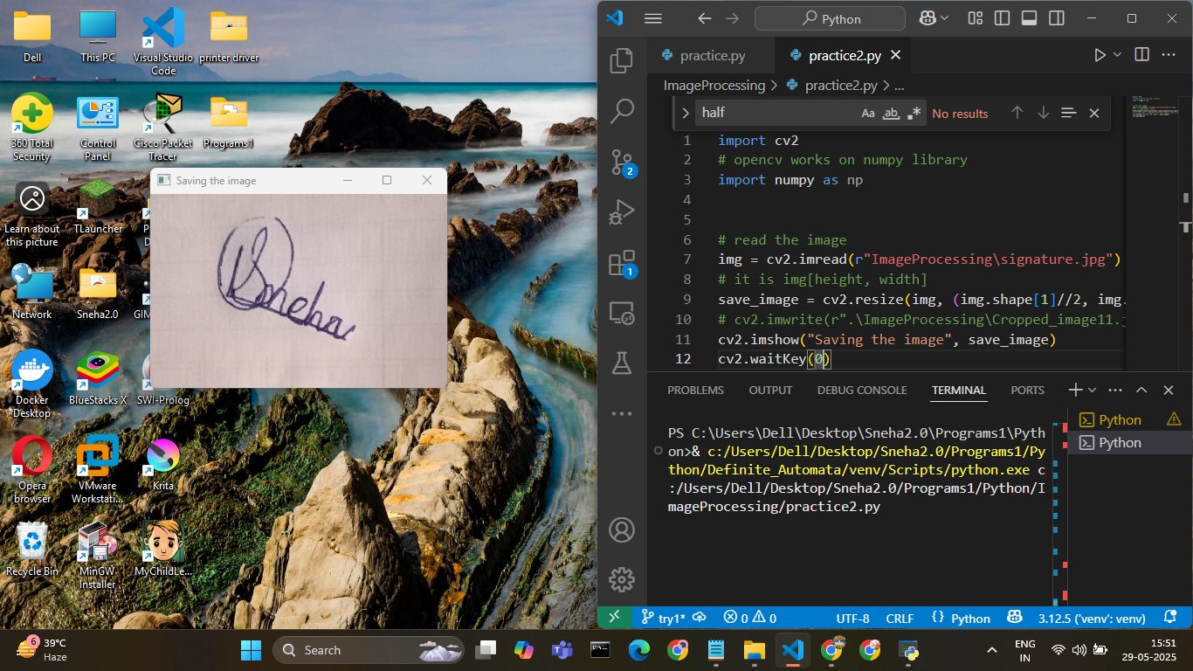
Basic Image Operations
Cropping the Image
# read the image
img = cv2.imread(r"ImageProcessing\signature.jpg")
# it is img[height, width]
cropped = img[100:400, 200:600]
# img[y1:y2, x1:x2]# cv2.imwrite(r".\ImageProcessing\Cropped_image11.jpg", save_image)
cv2.imshow("Saving the image", cropped)
cv2.waitKey(0)

Slide 12
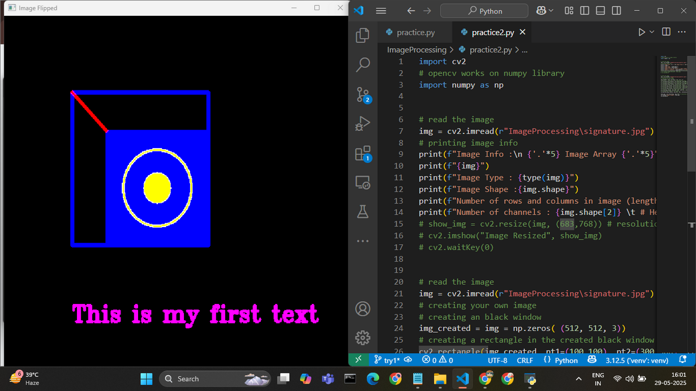
Image Manipulation
Drawing Shapes and Text
# CREATING YOUR OWN IMAGE
# creating an black window
IMG_CREATED = IMG = NP.ZEROS( (512, 512, 3))
# CREATING A RECTANGLE IN THE CREATED BLACK WINDOW
CV2.RECTANGLE(IMG_CREATED, PT1=(100,100), PT2=(300,300), COLOR=(255,0,0), THICKNESS=3)
# CREATING A RECTANGLE IN THE CREATED BLACK WINDOW WITH COLOR FILLED IN IT

Slide 13
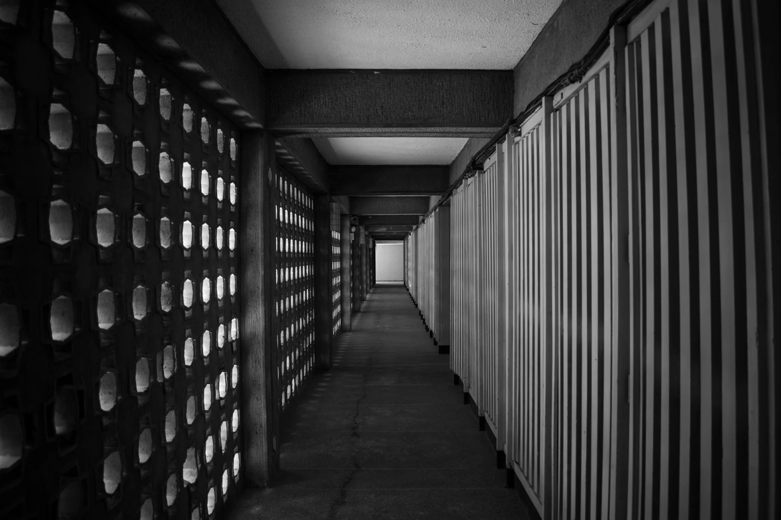

Image Manipulation
Drawing Shapes and Text
CV2.RECTANGLE(IMG_CREATED, PT1=(150,150), PT2=(300,300), COLOR=(255,0,0), THICKNESS=-100)
# creating a circle in the created black window
CV2.CIRCLE(IMG_CREATED, CENTER=(225,225), RADIUS=50, COLOR=(0,255,255), THICKNESS=2)
# CREATING A CIRCLE IN THE CREATED BLACK WINDOW WITH COLOR FILLED IN IT
CV2.CIRCLE(IMG_CREATED, CENTER=(225,225), RADIUS=20, COLOR=(0,255,255), THICKNESS=-1)
# CREATING A LINE IN THE CREATED BLACK WINDOW
CV2.LINE(IMG_CREATED, PT1=(100, 100), PT2=(150, 150), COLOR=(0,0,255), THICKNESS=3)

Slide 14

Image Manipulation
Drawing Shapes and Text
# INSerting the image in the window
CV2.PUTTEXT(IMG_CREATED, ORG=(100, 400), FONTSCALE=1, COLOR=(255,0,255), THICKNESS = 2, LINETYPE=CV2.LINE_AA, TEXT="THIS IS MY FIRST TEXT", FONTFACE=CV2.FONT_HERSHEY_TRIPLEX)
CV2.IMSHOW("CREATED IMAGE1", IMG_CREATED)
CV2.WAITKEY(0)

Slide 15
Draw rectangle interactively
Image Manipulation
IMPORT CV2
# OPENCV WORKS ON NUMPY LIBRARY
IMPORT NUMPY AS NP
# Read the image
# img = cv2.imread(r"ImageProcessing\signature.jpg")
# printing image info
# making the square using event handling
drawing = False
ix = -1
iy = -1
def draw(event,x,y,flags,params):
global drawing, ix, iy

Slide 16
Draw rectangle interactively
Image Manipulation
DEF DRAW(EVENT,X,Y,FLAGS,PARAMS):
GLOBAL DRAWING, IX, IY
IF EVENT == 1:
PRINT("MOUSe-Clicked : Start Drawing")
drawing = True
IX = x
iy = y
elif event == 0 and drawing == True:
print("Mouse-Draging : Start Drawing")
# cv2.rectangle(img_created3, pt1=(ix,iy), pt2=(x,y), color=(0,0,255), thickness=2)
elif event == 4:
drawing = False
CV2.RECTANGLE(img_created3, pt1=(ix,iy), pt2=(x,y), color=(0,0,255), thickness=2)

Slide 17
Drawing Shapes and Text
Image Manipulation
cv2.nameDWINDOW(WINNAME="COMPLEX_EVENT_HANDLING")
CV2.SETMOUSeCallback("Complex_Event_Handling", draw)
img_created3 = img = np.zeros( (683, 768, 3))
while True:
CV2.imshow("Complex_Event_Handling", img_created3)
if cv2.waitKey(1) & 0xFF == ord('x'):
break
# destroy all the windows
CV2.DESTroyAllWindows()

Slide 18

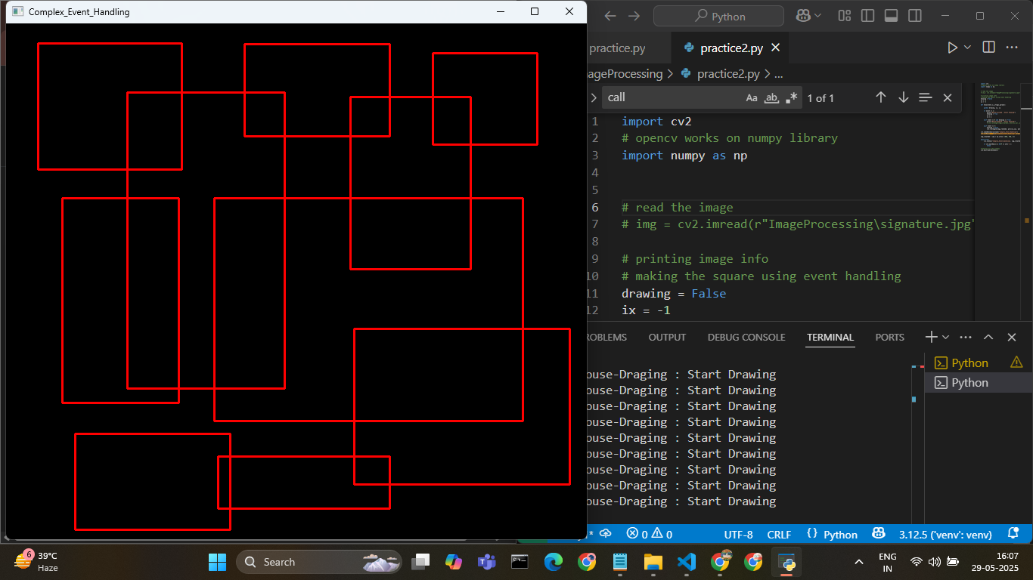
Drawing Shapes and Text

Slide 19
Making the Cropping Tool with Opencv
IMPORT CV2
# OPENCV WORKS ON NUMPY LIBRARY
IMPORT NUMPY AS NP
img = cv2.imread("ImageProcessing\signature.jpg")
# making the cropping tool using event handling
drawing = False
ix = -1
iy = -1
def draw(event,x,y,flags,params):
global drawing, ix, iy
if event == 1:
print("Mouse-Clicked : Start Drawing")
DRAWING = True
Image Manipulation

Slide 20

Making the Cropping Tool with Opencv
IX = X
IY = Y
ELIF EVENT == 0 AND DRAWINg == True:
print("Mouse-Draging : Start Drawing")
# cv2.rectangle(img_created3, pt1=(ix,iy), pt2=(x,y), color=(0,0,255), thickness=2)
elif event == 4:
drawing = False
# SAVing the cropped image
img_copy = img.copy()
cv2.rectangle(img, pt1=(ix,iy), pt2=(x,y), color=(0,0,255), thickness=2)
Image Manipulation

Slide 21
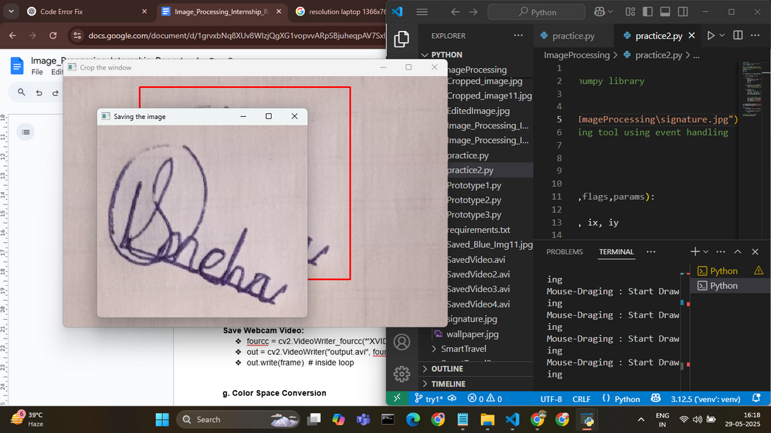
Making the Cropping Tool with Opencv
IX = X
IY = Y
ELIF EVENT == 0 AND DRAWINg == True:
print("Mouse-Draging : Start Drawing")
# cv2.rectangle(img_created3, pt1=(ix,iy), pt2=(x,y), color=(0,0,255), thickness=2)
elif event == 4:
drawing = False
# SAVing the cropped image
img_copy = img.copy()
cv2.rectangle(img, pt1=(ix,iy), pt2=(x,y), color=(0,0,255), thickness=2)

Slide 22
Making the Cropping Tool with Opencv
# IT IS IMG[HEIGHT, WIDTH]
SAVE_IMAGE = IMG_COPY[MIN(IY-1, Y-1):MAX(IY-1, Y-1), MIN(IX-1, X-1):MAX(IX-1, x-1)]
CV2.IMWrite(r".\ImageProcessing\Cropped_image.jpg", save_image)
cv2.imshow("Saving the image", save_image)
cv2.namedWindow(winname="Crop the window")
cv2.setMouseCallback("Crop the window", draw)
while True:
CV2.imshow("Crop the Window", img)
IF cv2.waitKey(1) & 0xFF == ord('x'):
break
# destroy all the windows
cv2.destroyAllWindows()

Slide 23

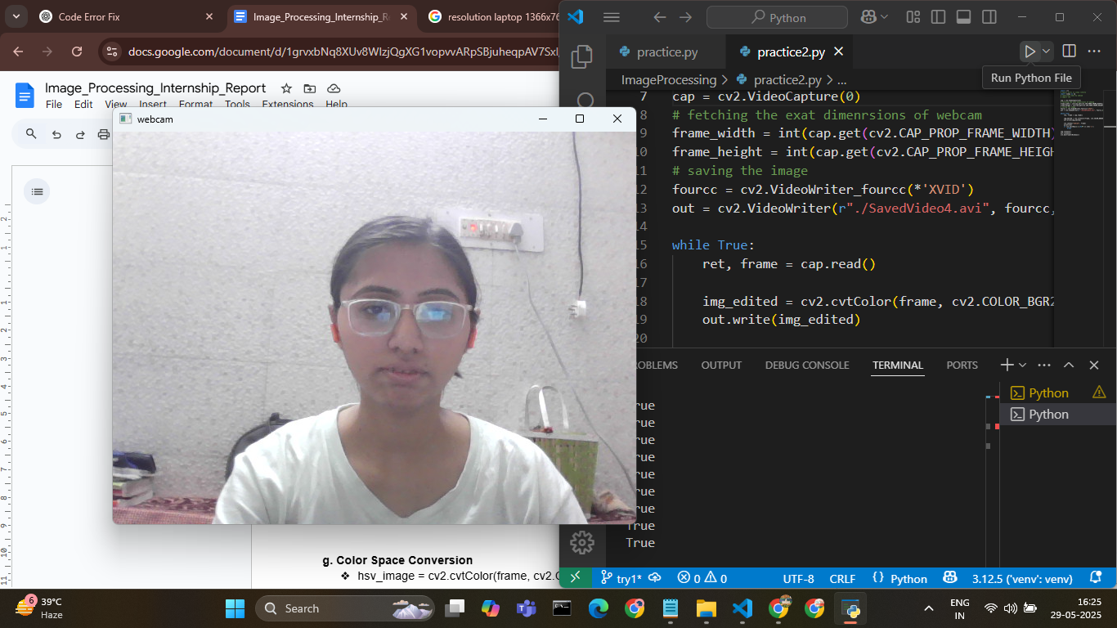
Working with Video
Capture from Webcam and Saving it:
import cv2
import numpy as np
cap = cv2.VideoCapture(0)
# fetching the exat dimenrsions of webcam
frame_width = int(cap.get(cv2.CAP_PROP_FRAME_WIDTH))
frame_height = int(cap.get(cv2.CAP_PROP_FRAME_HEIGHT))
# saving the image
fourcc = cv2.VideoWriter_fourcc(*'XVID')
out = cv2.VideoWriter(r"./SavedVideo4.avi", fourcc,20.00, (frame_width, frame_height))

Slide 24
Working with Video
Capture from Webcam and Saving it:
while True:
ret, frame = cap.read()
# img_edited = cv2.cvtColor(frame, cv2.COLOR_BGR2HSV)
out.write(frame)
cv2.imshow("webcam", frame)
print(ret)
if cv2.waitKey(1) & 0xFF == ord('x'):
break
cap.release()
out.release()
cv2.destroyAllWindows()

Slide 25
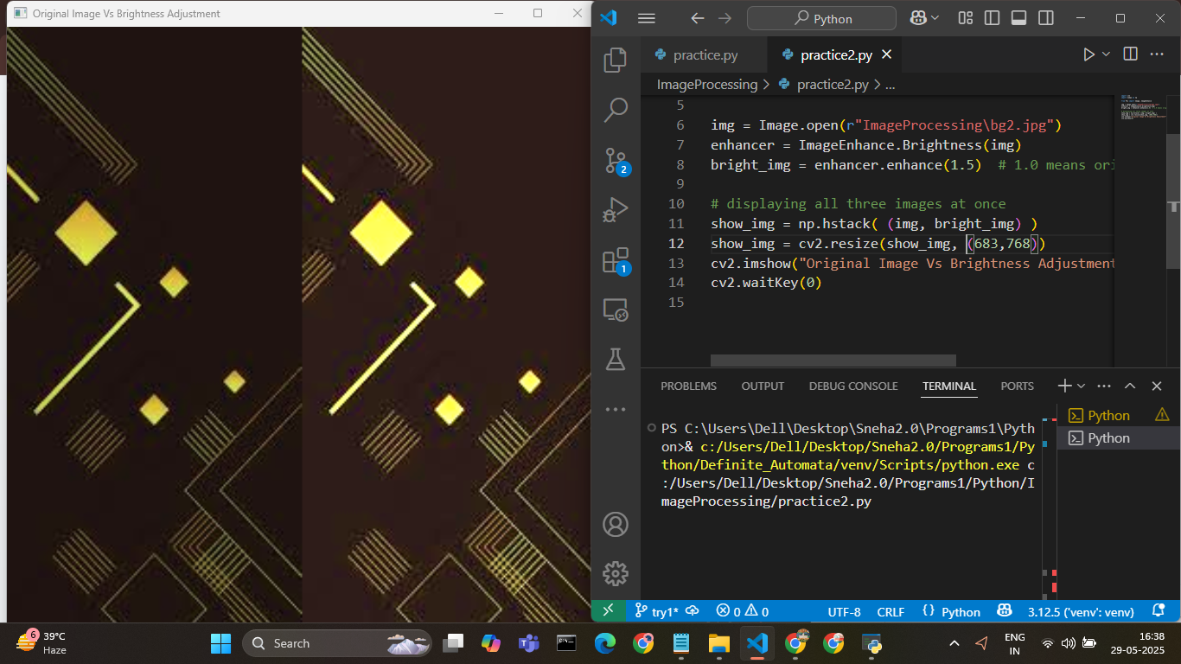
Image Enhancement
Introduction :
Image Enhancement in Python refers to the process of improving the visual appearance of an image or making it more suitable for analysis by modifying its features such as contrast, brightness, sharpness, or noise.
Python provides several libraries for image enhancement, especially:
OpenCV (cv2)
PIL / Pillow
scikit-image

Slide 26
Increases or decreases the light intensity of the image.
import cv2
import numpy as np
from PIL import Image, ImageEnhance
img = Image.open(r"ImageProcessing\bg2.jpg")
enhancer = ImageEnhance.Brightness(img)
bright_img = enhancer.enhance(1.5) # 1.0 means original, >1 brighter, <1 darker
# displaying all three images at once
show_img = np.hstack( (img, bright_img) )
show_img = cv2.resize(show_img, (683,768))
cv2.imshow("Original Image Vs Brightness Adjustment", show_img)
cv2.waitKey(0)

Slide 27
Contrast Adjustment : Improves the distinction between light and dark areas
import cv2
import numpy as np
from PIL import Image, ImageEnhance
img = Image.open(r"ImageProcessing\bg2.jpg")
enhancer = ImageEnhance.Contrast(img)
contrast_img = enhancer.enhance(2.0)
# displaying all three images at once
show_img = np.hstack( (img, contrast_img) )
show_img = cv2.resize(show_img, (683,768))
cv2.imshow("Original Image Vs Constrated Adjustment", show_img)
cv2.waitKey(0)

Slide 28
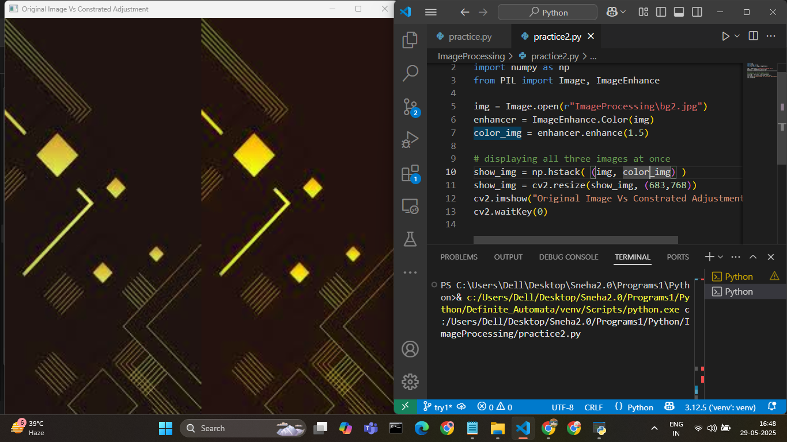
Sharpness Adjustment : Highlights edges and fine details.
img = Image.open(r"ImageProcessing\bg2.jpg")
enhancer = ImageEnhance.Sharpness(img)
sharp_img = enhancer.enhance(2.0)
# displaying all three images at once
show_img = np.hstack( (img, sharp_img) )
show_img = cv2.resize(show_img, (683,768))
cv2.imshow("Original Image Vs Constrated Adjustment", show_img)
cv2.waitKey(0)

Slide 29
Color Enhancement :
Changes the intensity of colors.
img = Image.open(r"ImageProcessing\bg2.jpg")
enhancer = ImageEnhance.Color(img)
color_img = enhancer.enhance(1.5)
# displaying all three images at once
show_img = np.hstack( (img, color_img) )
show_img = cv2.resize(show_img, (683,768))
cv2.imshow("Original Image Vs Constrated Adjustment", show_img)
cv2.waitKey(0)

Slide 30
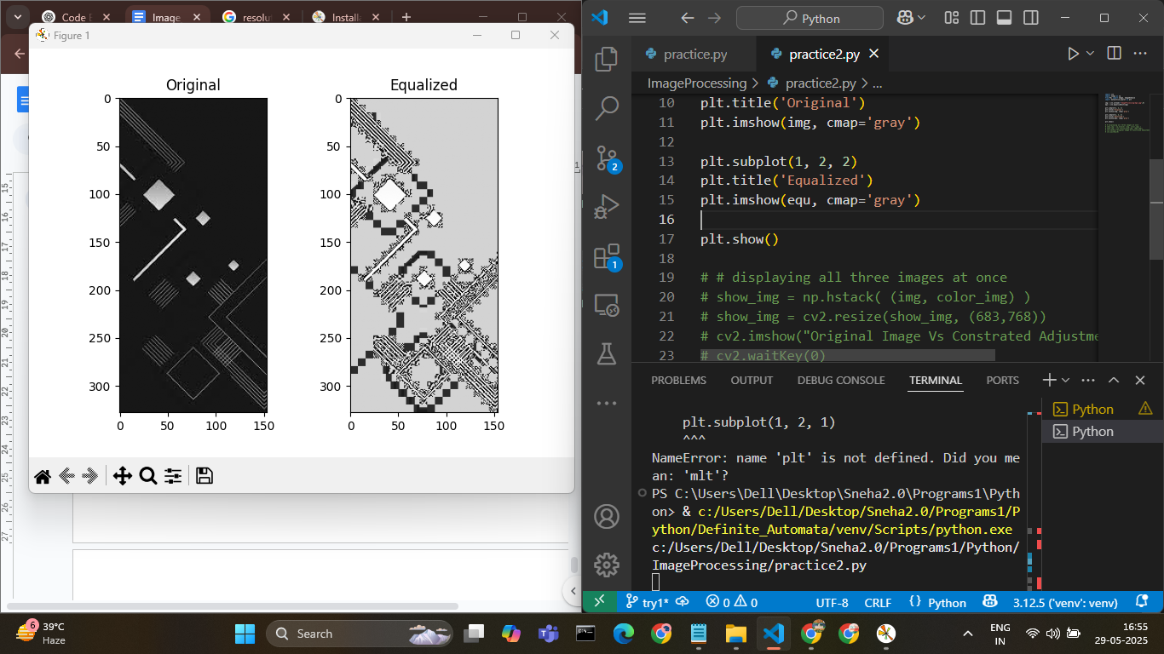
Histogram Equalization (with OpenCV)
import cv2
import numpy as np
from PIL import Image, ImageEnhance
import matplotlib.pyplot as plt
img = cv2.imread(r"ImageProcessing\bg2.jpg",0)
equ = cv2.equalizeHist(img)
plt.subplot(1, 2, 1)
plt.title('Original')
plt.imshow(img, cmap='gray')
plt.subplot(1, 2, 2)
plt.title('Equalized')
plt.imshow(equ, cmap='gray')
plt.show()

Slide 31
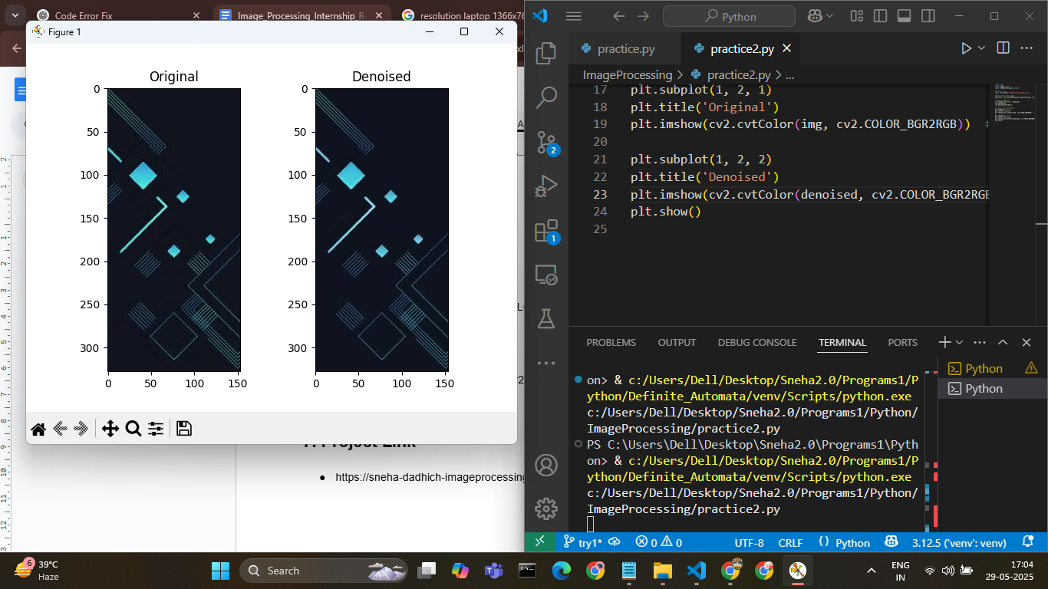
Histogram Equalization (with OpenCV)
import cv2
import numpy as np
from PIL import Image, ImageEnhance
import matplotlib.pyplot as plt
img = cv2.imread(r"ImageProcessing\bg2.jpg",0)
equ = cv2.equalizeHist(img)
plt.subplot(1, 2, 1)
plt.title('Original')
plt.imshow(img, cmap='gray')
plt.subplot(1, 2, 2)
plt.title('Equalized')
plt.imshow(equ, cmap='gray')
plt.show()

Slide 32
Conclusion
During this initial phase of my internship, I explored the fundamentals of image processing using Python and OpenCV. I gained hands-on experience with basic image operations, enhancement techniques, and video handling. I also built an interactive Streamlit-based tool for image manipulation, which helped reinforce my understanding of real-time applications. This assignment has laid a strong foundation for more advanced topics such as segmentation, edge detection, and deep learning-based image analysis, which I look forward to exploring in the upcoming phases of the internship.

